Slide 1
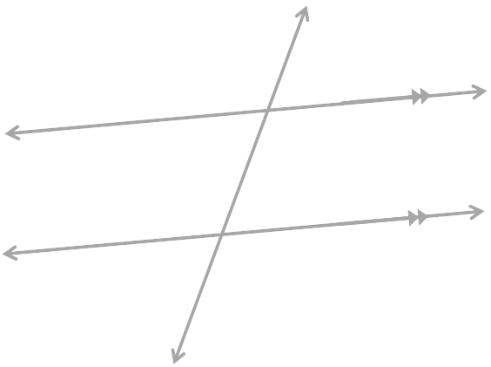
Parallel Lines and a Transversal Line
t
m
n

Slide 2
Alternate
Interior
Angles
If a transversal line passes through parallel lines the ALTERNATING INTERIOR ANGLES are CONGRUENT.
Another pair of angles that could be described as Alternating Interior Angles.
t
m
65°
Interior
115°
115°
65°
n
This pair would also be congruent.
Plane H

Slide 3
Alternate
Exterior
Angles
If a transversal line passes through parallel lines the ALTERNATING EXTERIOR ANGLES are CONGRUENT.
Another pair of angles that could be described as Alternating Exterior Angles.
Exterior
t
115°
65°
m
n
65°
115°
This pair would also be congruent.
Exterior
Plane H

Slide 4
Corresponding
Angles
If the transversal passes through parallel lines the CORRESPONDING ANGLES are CONGRUENT.
There are 4 pairs of CORRESPONDING ANGLES.
t
115°
65°
m
65°
115°
115°
65°
n
65°
115°
Plane H

Slide 5
Consecutive
Interior
Angles
If the transversal passes through parallel lines the CONSECUTIVE INTERIOR ANGLES are SUPPLEMENTARY.
Another pair of angles that could be described as Consecutive Interior Angles.
t
m
65°
115°
115°
Interior
+
= 180°
115°
65°
65°
n
This pair would also be supplementary.
Plane H

Slide 6
Consecutive
Exterior
Angles
If the transversal passes through parallel lines the CONSECUTIVE EXTERIOR ANGLES are SUPPLEMENTARY.
Another pair of angles that could be described as Consecutive Exterior Angles.
Exterior
t
115°
65°
65°
m
+
= 180°
n
115°
65°
115°
Exterior
This pair would also be supplementary.
Plane H

