Slide 1
Powers and Exponents

Slide 2
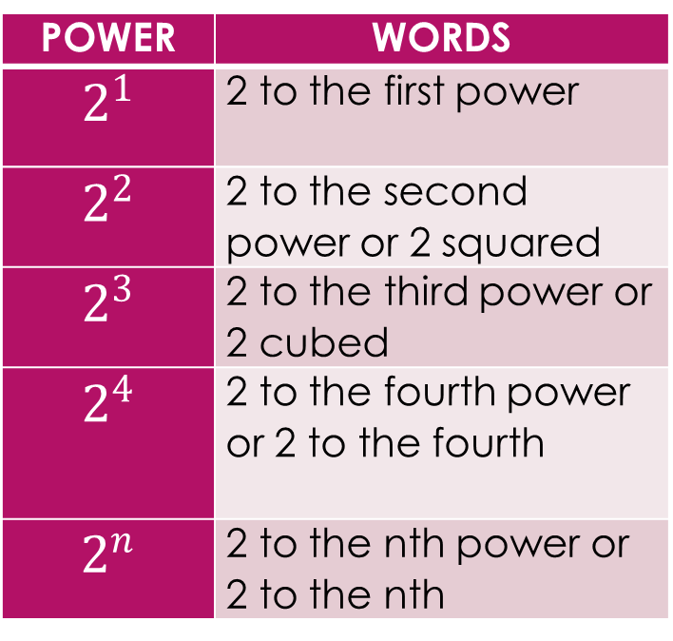
Vocabulary
POWER | WORDS
$$2^{1}$$ | 2 to the first power
$$2^{2}$$ | 2 to the second power or 2 squared
$$2^{3}$$ | 2 to the third power or 2 cubed
$$2^{4}$$ | 2 to the fourth power or 2 to the fourth
$$2^{n}$$ | 2 to the nth power or 2 to the nth
Power – numbers using an exponent and base
Base – the common factor in a power
Exponent – the number of times the base is used as a factor

Slide 3

Powers and Exponents
Exponential Form
Expanded Form
Standard Form
$$3^{5}$$
3 · 3 · 3 · 3· 3
243

Slide 4
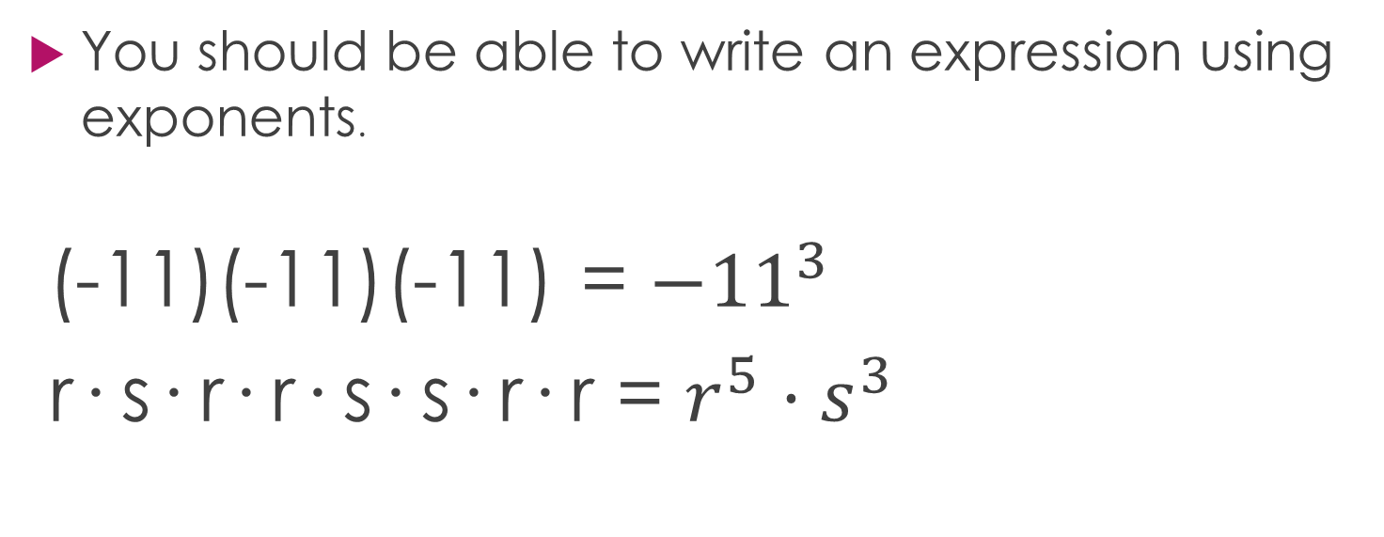
Writing Powers
You should be able to write an expression using exponents.
(-11)(-11)(-11) = ${−11}^{3}$
r· s· r· r· s· s· r· r = $r^{5}·s^{3}$

Slide 5
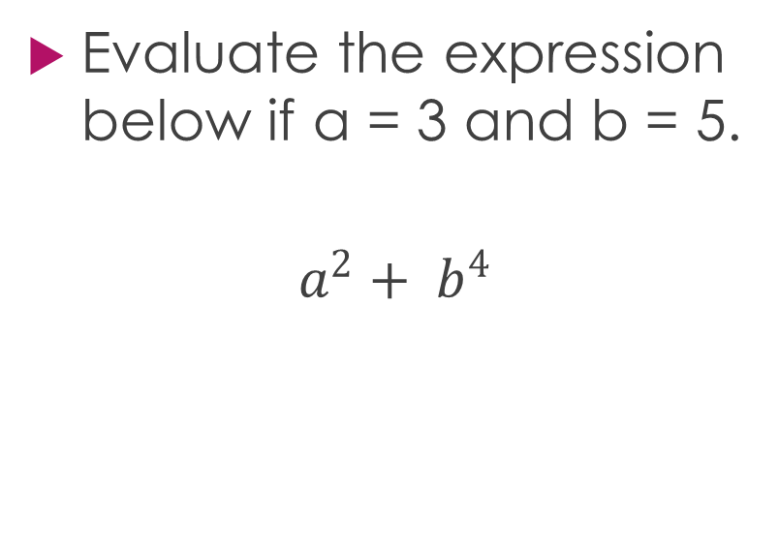
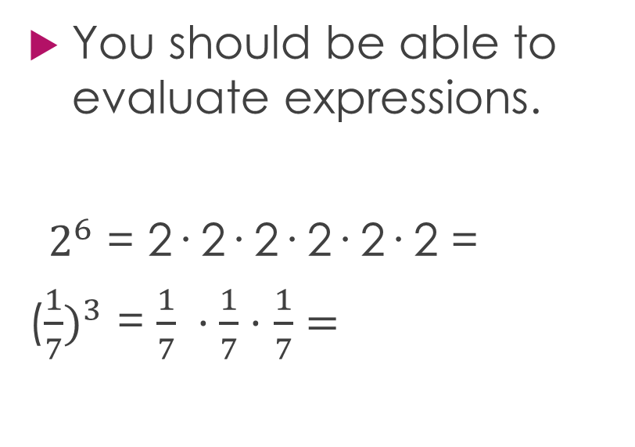
Evaluating Powers
You should be able to evaluate expressions.
${ 2}^{6}$ = 2· 2· 2· 2· 2· 2 =
(${\frac{1}{7})}^{3}$ = $\frac{1}{7} ·\frac{1}{7}·$ $\frac{1}{7}=$
Evaluate the expression below if a = 3 and b = 5.
$$a^{2}+ b^{4}$$

Slide 6
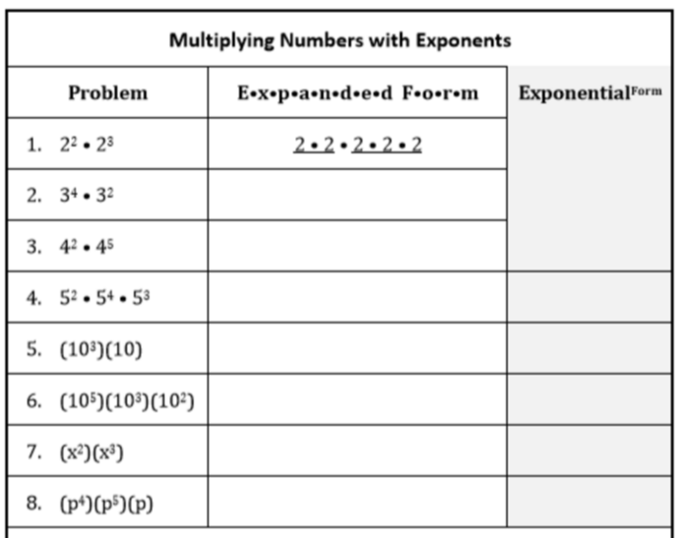
Investigation

Slide 7
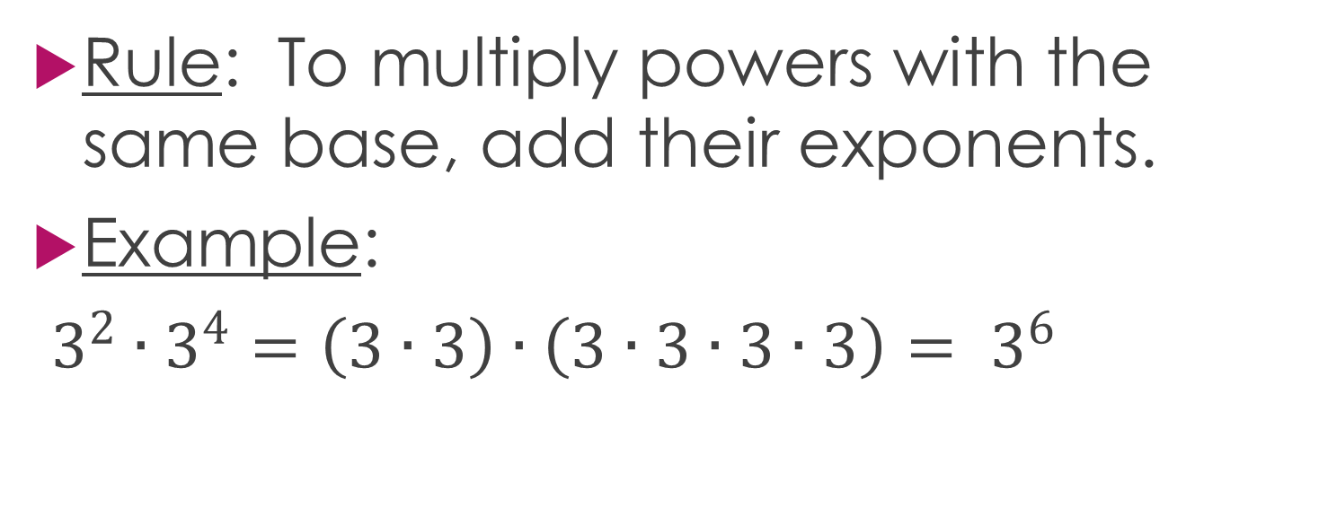
Product of Powers Rule
Rule: To multiply powers with the same base, add their exponents.
Example:
$3^{2}∙3^{4}=\left(3∙3\right)∙\left(3∙3∙3∙3\right)= 3^{6}$

Slide 8
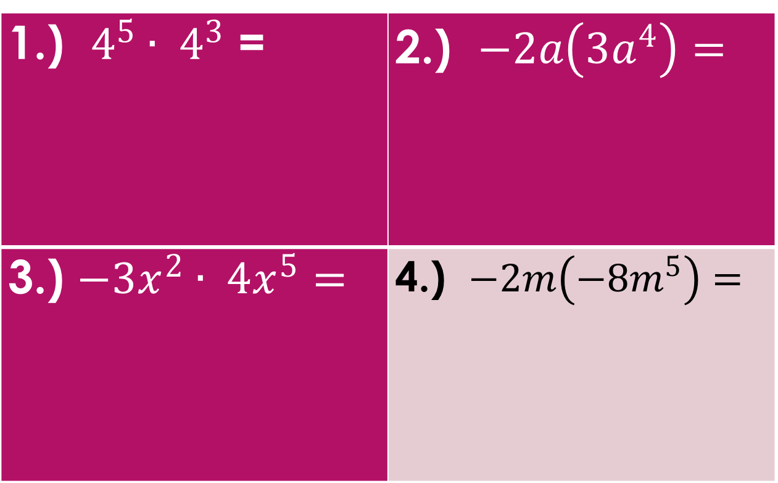
1.) $4^{5}∙ 4^{3}$ = | 2.) $−2a\left(3a^{4}\right)=$
3.) ${−3x}^{2}∙ {4x}^{5}=$ | 4.) $−2m\left(−8m^{5}\right)=$

Slide 9
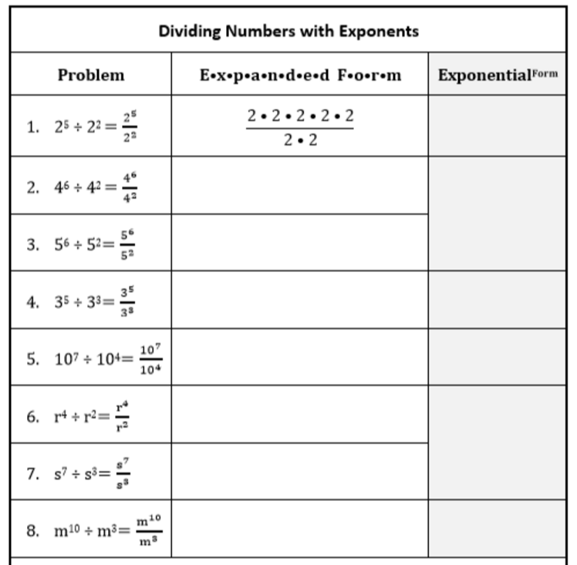
Investigation

Slide 10
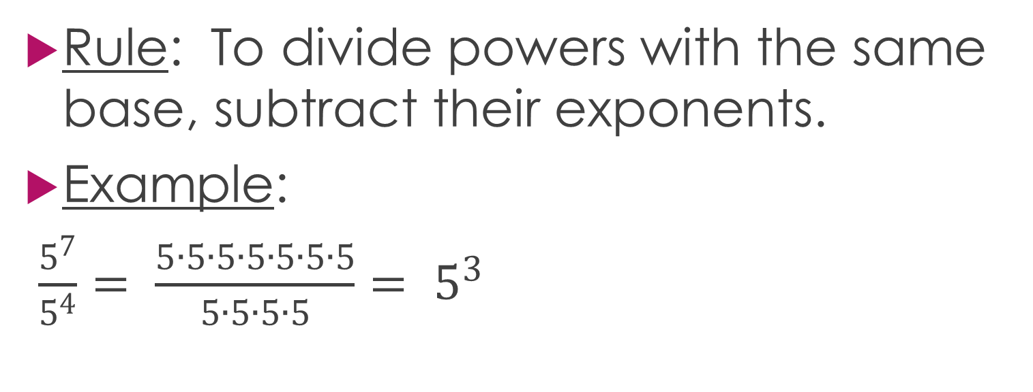
Quotient of Powers
Rule: To divide powers with the same base, subtract their exponents.
Example:
$\frac{5^{7}}{5^{4}}= \frac{5∙5∙5∙5∙5∙5∙5}{5∙5∙5∙5}{= 5}^{3}$

Slide 11
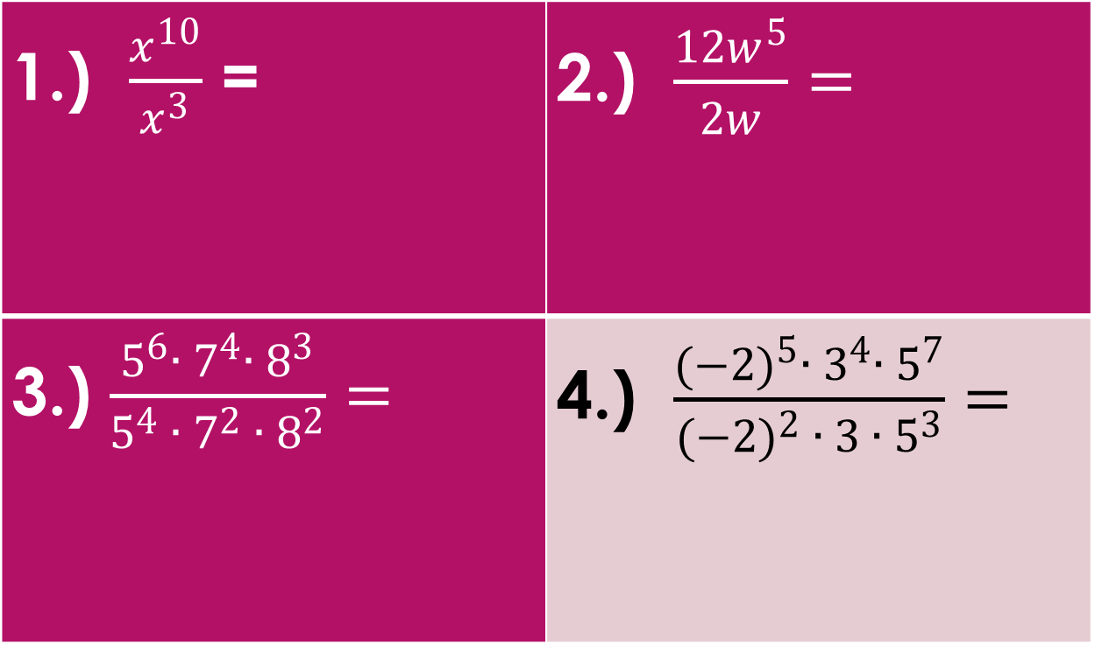
1.) $\frac{x^{10}}{x^{3}}$ = | 2.) $\frac{12w^{5}}{2w}=$
3.) $\frac{5^{6}∙ 7^{4}∙ 8^{3}}{5^{4} ∙ 7^{2} ∙ 8^{2}}=$ | 4.) $\frac{{(−2)}^{5}∙ 3^{4}∙ 5^{7}}{{(−2)}^{2} ∙ 3 ∙ 5^{3}}=$

Slide 12
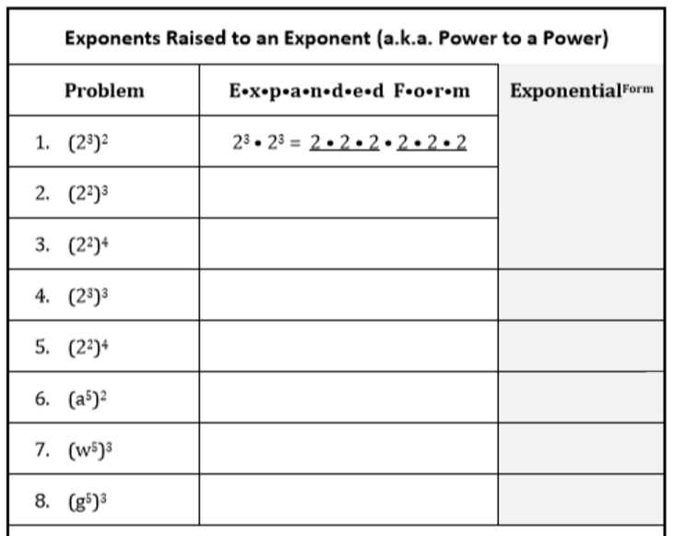
Investigation

Slide 13
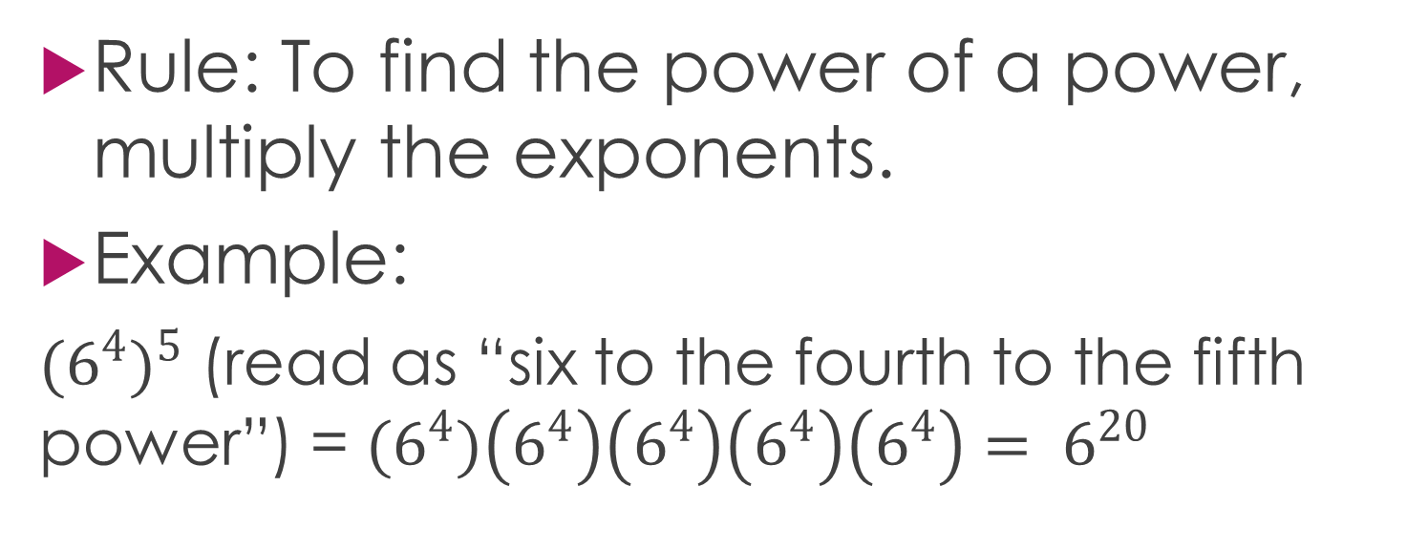
Power of a Power
Rule: To find the power of a power, multiply the exponents.
Example:
$({6^{4})}^{5}$ (read as “six to the fourth to the fifth power”) = ${(6}^{4})\left(6^{4}\right)\left(6^{4}\right)\left(6^{4}\right)\left(6^{4}\right)= 6^{20}$

Slide 14
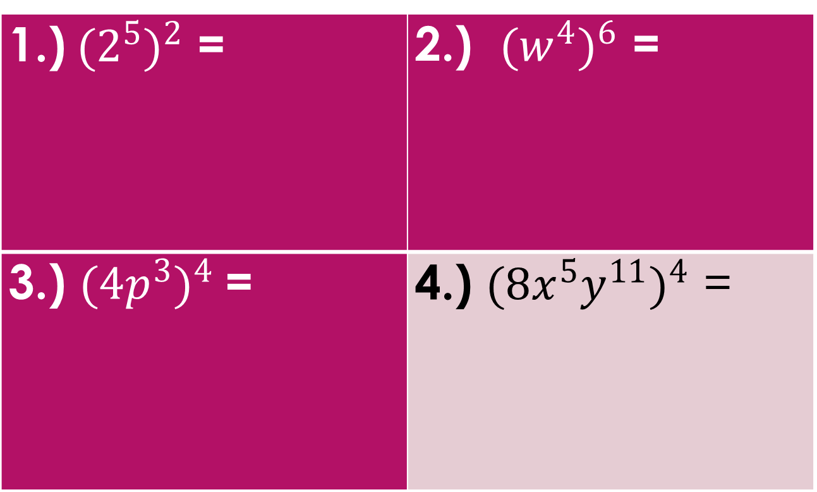
1.)$({2^{5})}^{2}$ = | 2.) $({w^{4})}^{6}$ =
3.) $(4{p^{3})}^{4}$= | 4.) $(8{x^{5}y^{11})}^{4}$ =

